Slide 1
solving Linear Equations using LU Decomposition
Course Instructor
Engr. Zoobia Zeeshan
ZoobiaZeeshan.bukc@bahria.edu.pk

Slide 2
Linear Equation in NA
LU decomposition of a matrix is the factorization of a given square matrix into two triangular matrices.
One upper triangular matrix and one lower triangular matrix, such that the product of these two matrices gives the original matrix.
It was introduced by Alan Turing in 1948, who also created the Turing machine.
This method of factorizing a matrix as a product of two triangular matrices has various applications such as a solution of a system of equations, which itself is an integral part of many applications such as finding current in a circuit and solution of discrete dynamical system problems; finding the inverse of a matrix and finding the determinant of the matrix.

Slide 3
Direct methods
Direct methods are techniques that attempt to find the exact solutions of linear systems by applying a finite number of operations, such as matrix factorization, elimination, or inversion.
Some examples of direct methods are Newton's method, Gaussian elimination, and QR decomposition.
Direct methods have the advantage of being fast, reliable, and easy to implement, but they also have some drawbacks, such as requiring a lot of memory and computational resources, being sensitive to round-off errors, and failing to converge or produce accurate results for some systems.
Iterative methods
Iterative methods are techniques that start with an initial guess or approximation of the solutions of linear systems, and then refine it by applying a sequence of operations, such as function evaluation, linearization, or correction, until a desired level of accuracy or convergence is reached.
Some examples of iterative methods are fixed-point iteration, bisection method, and secant method. Iterative methods have the advantage of being flexible, adaptable, and efficient, but they also have some drawbacks, such as requiring a good initial guess, being dependent on the choice of parameters or stopping criteria, and converging slowly or diverging for some systems.

Slide 4
LU Decomposition/Triangularization method
LU decomposition of a matrix is the factorization of a given square matrix into two triangular matrices.
One upper triangular matrix and one lower triangular matrix, such that the product of these two matrices gives the original matrix.
It was introduced by Alan Turing in 1948, who also created the Turing machine.
This method of factorizing a matrix as a product of two triangular matrices has various applications such as a solution of a system of equations, which itself is an integral part of many applications such as finding current in a circuit and solution of discrete dynamical system problems; finding the inverse of a matrix and finding the determinant of the matrix.

Slide 5
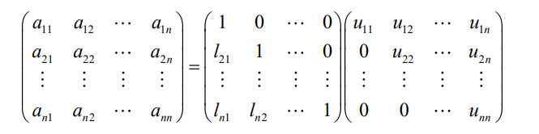
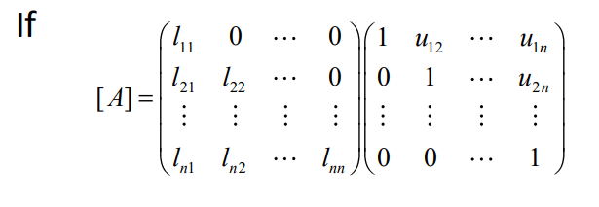
LU Decomposition Types
Doolittle LU Decomposition
[A] = [L][U]
If we factorize in such a way that
i.e. diagonal elements of [L] are 1, then the approach is Doolittle’s method.
Crout’s LU Decomposition method

Slide 6
DOOLITTLES’S METHOD

Slide 7

A square matrix A can be decomposed into two square matrices L and U such that A = L U
Where U is an upper triangular matrix formed as a result of applying the Gauss Elimination Method on A, and L is a lower triangular matrix with diagonal elements being equal to 1.

Slide 8

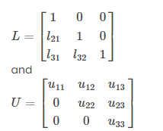

Consider the system of equations in three variables:
a₁₁x₁ + a₁₂x₂ + a₁₃x₃ = b₁
a₂₁x₁ + a₂₂x₂ + a₂₃x₃ = b₂
a₃₁x₁ + a₃₂x₂ + a₃₃x₃ = b₃
These can be written in the form of AX = B as:
Step 1: Generate a matrix A = LU
Step 2: Now, we can write AX = B as:
LUX = B….(1)
Step 3: Let us assume UX = Y….(2)
Step 4: From equations (1) and (2), we have;
LY = B
On solving this equation, we get y₁, y₂, y₃.
Step 5: Substituting Y in equation (2), we get UX = Y
By solving equation, we get X, x₁, x₂, x₃.

Slide 9

Example
Solve the system of equations x₁ + x₂ + x₃ = 1, 3x₁ + x₂ – 3x₃ = 5 and x₁ – 2x₂ – 5x₃ = 10 by LU decomposition method.
Solution:
Given system of equations are:
x₁ + x₂ + x₃ = 1
3x₁ + x₂ – 3x₃ = 5
x₁ – 2x₂ – 5x₃ = 10
These equations are written in the form of AX = B as:
Step 1: Let us write the above matrix as LU = A.
That means,

Slide 10


By expanding the left side matrices, we get;
Thus, by equating the corresponding elements, we get;
u₁₁ = 1, u₁₂ = 1, u₁₃ = 1
l₂₁u₁₁ = 3,
l₂₁u₁₂ + u₂₂ = 1,
u₂₁u₁₃ + u₂₃ = -3
l₃₁u₁₁ = 1,
l₃₁u₁₂ + l₃₂u₂₂ = -2,
l₃₁u₁₃ + l₃₂u₂₃ + u₃₃ = -5
Solving these equations, we get;
u₂₂ = -2, u₂₃ = -6, u₃₃ = 3
l₂₁ = 3, l₃₁ = 1, l₃₂ = 3/2

Slide 11

Step 2: LUX = B
Step 3: Let UX = Y
Step 4: From the previous two steps, we have LY = B
Thus,
So,
y₁ = 1
3y₁ + y₂ = 5
y₁ + (3/2)y₂ + y₃ = 10
By Solving these equations, we get;
y₁ = 1, y₂ = 2, y₃ = 6

Slide 12

Step 5: Now, consider UX = Y. So,
By expanding this equation, we get;
x₁ + x₂ + x₃ = 1
-2x₂ – 6x₃ = 2
3x₃ = 6
Solving these equations, we can get;
x₃ = 2, x₂ = -7 and x₁ = 6
Therefore, the solution of the given system of equations is (6, -7, 2).

Slide 13
CROUT’S METHOD

Slide 14
Example
Solve Equations 2x+3y-z=5, 3x+2y+z=10, x-5y+3z=0 using Crout's method

Slide 15
Exercises
Question # 01:
Solve Equations x+y+z=1, 4x+3y-z=6, 3x+5y+3z=4 using Doolittle’s method
Question # 02:
Solve Equations 2x+y+2z=2, x+5y+3z=4, x+y-z=0 using Crout's method

